Slide 1





PRESENTATION 2026
Student Name
Student Email
Prachi Nitin Palkar
prachiii1856@gmail.com
Mentor Name
Umamaheshwari Ma’am

Slide 2

Outline
Abstract of the Project
Problem Statement
Proposed Solution
System Architecture
Live Demo of the Project
Embedded Video of Project
Conclusion
Future Scope

Slide 3
Abstract
1.Project Overview
This project focuses on transforming raw inventory and order fulfillment data into meaningful insights using Microsoft Excel and Power BI.
2. Objective
The main objective is to clean and analyze data to improve inventory management and business decision making. The dataset contains issues such as duplicate records, missing values, and inconsistent categories, which are corrected using Excel data cleaning techniques and create an interactive dashboard using PowerBI to get business insights.

Slide 4
Abstract
3. Tools Used
Analysis is performed using Pivot Tables and formulas in Excel, and the results are visualized through interactive dashboards in Power BI.
4. Expected Outcomes
The final outcome helps businesses track stock levels, monitor order fulfillment, and improve operational efficiency.
5.Unique aspects
Use of Excel + Power BI for real-world business analysis
Focus on inventory and order fulfillment insights
Creation of interactive dashboards with KPIs

Slide 5

Problem Statement
Business related problems
Poor data quality (duplicates, missing values) leads to wrong business decisions
Lack of proper dashboards results in limited visibility of inventory & sales performance
Inefficient inventory tracking causes stock shortages or overstocking
Manual data analysis is time-consuming and reduces productivity
Inconsistent product categorization leads to revenue miscalculations and reporting errors
Problematic for Retail businesses, Inventory managers, E-commerce companies, Business decision makers, etc. to take business related decisions

Slide 6

Proposed Solution
This project uses Excel and Power BI to solve inventory and fulfillment issues.
Use Excel for data cleaning to ensure accurate and reliable business data
Apply Pivot Tables & formulas for quick and efficient data analysis
Develop interactive Power BI dashboards for real-time business insights
Track key metrics like stock levels, order fulfillment, and category performance
Enable data-driven decision-making to improve efficiency and profitability

Slide 7
System Architecture
Data Input / Source
Processing / Analysis
AI / Tool Integration
Output / Dashboard

Slide 8
1. Data input/ Source
Excel dataset from Kaggle
Contains:
Order ID
Product Name
Category
Stock levels
Order status
3. Tool Integration
Microsoft Excel → Data cleaning & analysis
Power BI → Data visualization & dashboard creation
2. Processing / Analysis (Excel)
Removing duplicates using Remove Duplicates tool
Handling missing values using Find & Replace
Standardizing categories using Replace function
Correcting data types using filters and formatting
Data validation using Conditional Formatting
Analysis Techniques:
Pivot Tables
Sorting & Filtering
Basic Excel formulas
4. Output / Dashboard (Power BI)
Interactive dashboard with:
KPI cards
Bar charts
Pie charts
Insights Generated:
Stock availability
Category-wise performance
Region-wise analysis
Order fulfillment tracking

Slide 9
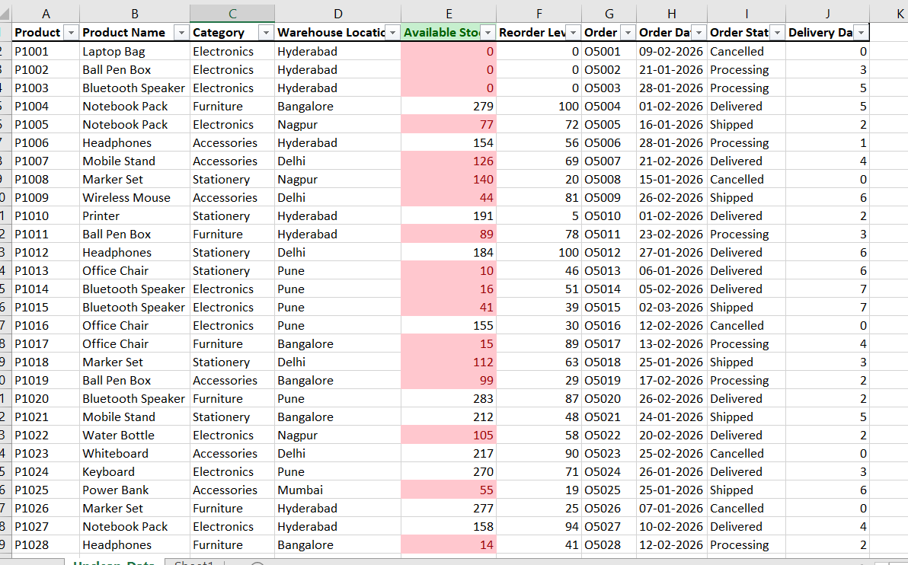
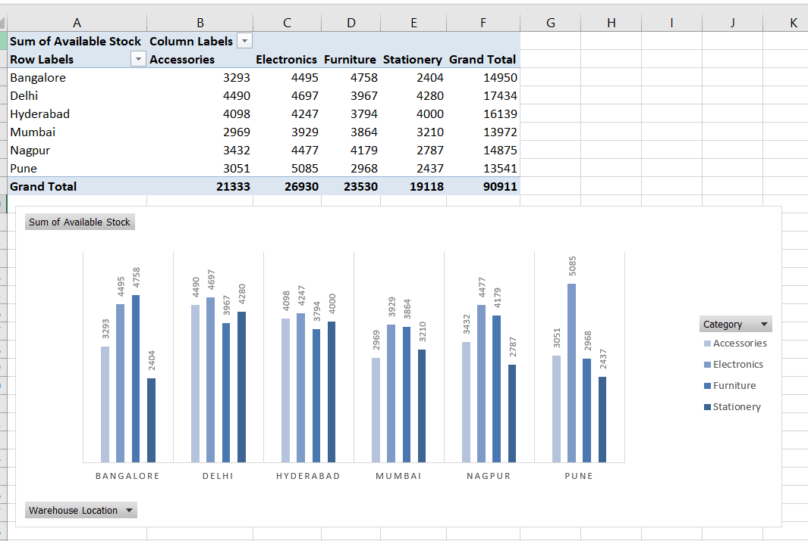
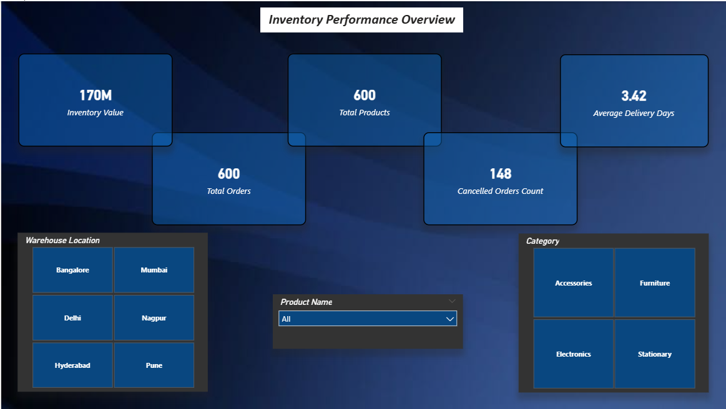
Live Demo of Project
Here's the list of some demo screenshots / features of the project:
Demo 1
Demo 2
Demo 3
[Add description of Demo 2 here — what this demo shows, key features, and results achieved.]

Slide 10
Video of Project Demo
https://app.powerbi.com/groups/me/reports/1c7075d5-7d48-4f42-9489-e53c8992eeed/bdc068c312020b52ab0f?experience=power-bi
▶
[Insert your project demo video.
You can embed a video your live project.]

Slide 11

Conclusion
This project successfully converted raw inventory data into structured and meaningful information using Excel and Power BI.
Key achievements:
Cleaned and organized dataset
Performed effective data analysis
Created interactive dashboards
Improved inventory tracking and reporting
The project demonstrates how Excel and Power BI can be used effectively for business data analysis and decision-making.
CONCLUSION

Slide 12

Future Scope
Integration with live databases
Automation using Power BI refresh
Advanced dashboards with more KPIs
Integration with business systems Expansion to larger datasets

Slide 13
Thank You
AICW Fellowship | Student Project Presentation 2026
LinkedIn | Edunet Foundation

